Slide 1
Ces waiver training 2024

Slide 2
Changes effective March 2024

Slide 3
Changes for supportive living
Authorizations will be effective for 1 year starting 3/1/2024.
No longer 6 months
This DOES NOT effect authorizations that were created prior to 3/1/2024.
Billing will remain the same for current authorizations.
Can submit request up to 30 days before end date of current waiver authorization.
H2016 UF only modifier for all 1:1 services
No longer using UF for hours 1-16 and UH for hours 17-24.
Custom Rate request now using H2016 U5 (not U3).
H2016 U1 UQ only modifier for Shared Staffing 2-4 members
No longer using U1 UQ for hours 1-16 and U3 UQ for hours 17-24.

Slide 4
All other changes
Respite services using S5151, no longer requires modifiers.
All hours pay at the same rate.
T2025 Consultation cap and limit changes (see slide for further details).
U3 removed from the annual cap to eliminate barriers to testing.
Adaptive Equipment Personal Emergency Response System now under S5162 for purchase, rental, and repair.
Environmental Modification and Adaptive Equipment maximum increased to $12,000 annually. See slide for additional requirements.

Slide 5
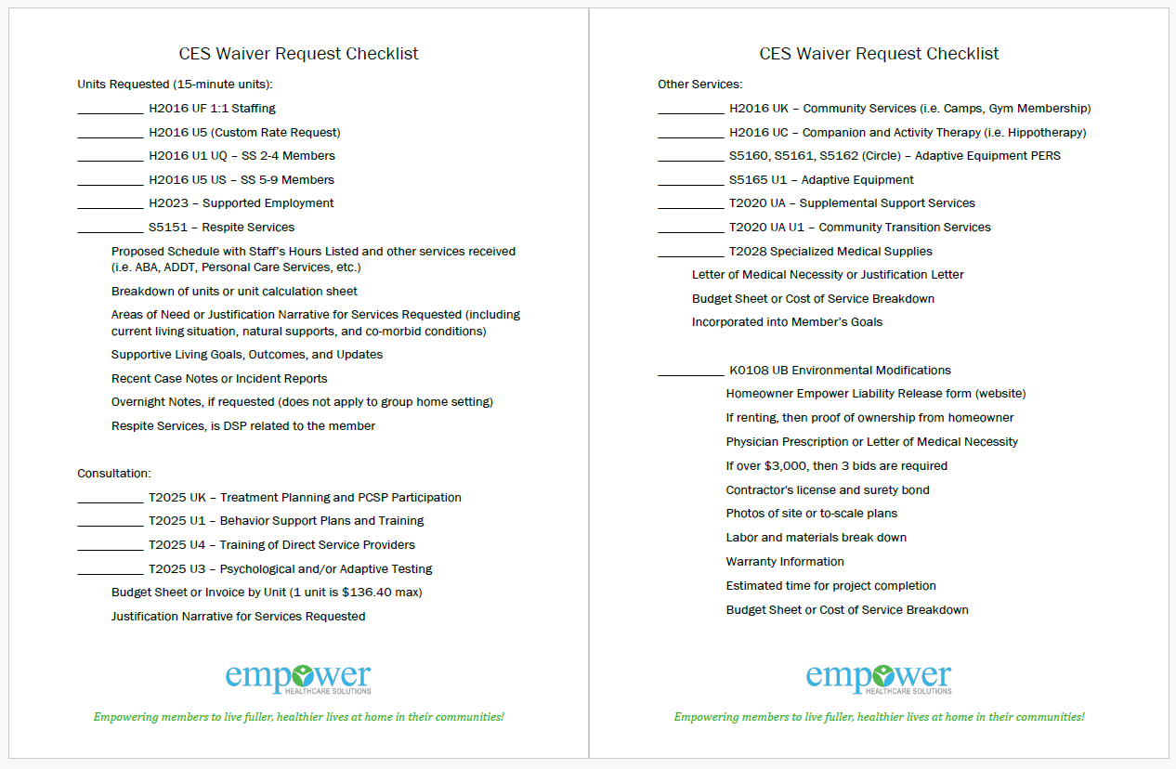
Submission checklist

Slide 6
Supportive living submissions

Slide 7
CPT Codes and modifiers for staff
1:1 Staffing
H2016 UF – All Units
H2016 U5 – Custom Rate Request
2-4 Members Shared Staffing
H2016 U1 UQ – All Units
5-9 Members Shared Staffing
H2016 U5 US – All Units
Respite Services
S5151 – All Units

Slide 8
Required documentation
Proposed schedule with staff listed.
Breakdown of units or unit calculation sheet, including holidays or out of school coverage needs.
Narrative for justification of services requested, including current living situation, natural supports, and co-morbid conditions.
Supportive living goals and updates
Recent case notes for behavior concerns or supporting documentation from incident reports.
Overnight notes to support ongoing 1:1 need, if in schedule. Not required if member is in a group home.

Slide 9
Required documentation
Overnight staff notes should include, if applicable:
If the member is sleeping throughout the night, then what is the need or reason for staff?
Member’s activities throughout the night
Assistance required for bathroom needs or changes required throughout the night

Slide 10
Things we consider
Community Engagement
Natural and/or Family Support
Behavior Issues (i.e. elopement, aggression, etc.)
School
ADDT or Supported Employment
Comorbid Medical Conditions
Personal Care Services
Level of Functioning

Slide 11
Supportive living
H2016 UK – Community Services
Camps
Gym Memberships
Other Activities in the Community
H2016 UC – Companion and Activity Therapy
Hippotherapy
H2016 UD and UD US – Transportation
5,000 miles with no PA required

Slide 12
Required documentation
Letter of medical necessity from PCP or justification of service
Budget sheet or cost of service breakdown
How does this accomplish the member’s goals?
Must be submitted BEFORE the service occurs.
Cannot already be paid and then reimbursed.

Slide 13
Other waiver requests

Slide 14
consultation
UK – PCSP Participation
2 units annual maximum
Provider required to attend PSCP and sign cooperative agreement.
Goals from PCSP should be incorporated into the Supportive Living goals.
U3 – Testing
Testing must be conducted by a Psychologist, LPE, MD, or SLP (adaptive only).
Empower Care Coordinator can assist with locating the testing date from DDS.
U4 – Training of DSP
Attestation by provider must include training was conducted in any of the following areas:
PCSP goals
Behaviors specific to the member
Safety plan
Nursing Consults
Medication Management including MAR, list of medications, and side effects.
Maximum of 5 units annually, but based on need for nursing consults.

Slide 15
consultation
U1 – Behavior Support Plans/Training
Risk Mitigation Plan conducted by the CC determines if/which plan should be submitted.
PBSP – Positive Behavior Support Plan - high risk members.
BPIP –Behavior Prevention and Intervention Plan - low/medium risk members.
Initial request for 2 units to complete plan.
Provider to submit the plan for additional units to be approved.
Maximum of 5 units annually for behavior planning.
If plan is submitted at time of request, then 5 units can be approved initially.
Empower is required to have these plans on file.
Travis Gray at Empower can help!

Slide 16
Consultation
Authorizations will be effective for 1 year.
Consultation can provide up to 9 units combined between UK, U1, and U4 annually. Still reviewed for necessity and need.
$136.40 per unit is still the maximum.
U3 will be standalone and not part of the annual max.
Required Documentation:
Budget Sheet with Consultation breakdown
Justification Narrative of consultation requested.
PBSP or BPIP must be submitted for additional units
Can be submitted with the Supportive Living request or standalone.

Slide 17
Environmental modifications
Increased annual max to $12,000
Estimates over $3,000 require 3 bids.
Limits:
1 fence per lifetime
Claims:
Must submit Site Survey for reimbursement (new this year)
Limit is still combined with adaptive equipment

Slide 18
Environmental modifications
To obtain the 20% admin fee for Environmental Modifications, the waiver provider will be responsible for obtaining and submitting the request, including the contractor bids.
New Waiver for Environmental Modifications must be signed by the homeowner and submitted with the request.
Site Survey and Customer Satisfaction form must be submitted with the claim.
**New forms are located on our website.**

Slide 19
Environmental modifications
Provider will be responsible for obtaining and submitting the following documentation:
Homeowner Empower Liability Release form (new this year)
Physician's prescriptions and medical justification
3 itemized bids for over $3,000
Contractor's license and surety bond
Warranty Information
Photos of site or to-scale plans
Labor and materials break down
Estimated time for project completion

Slide 20
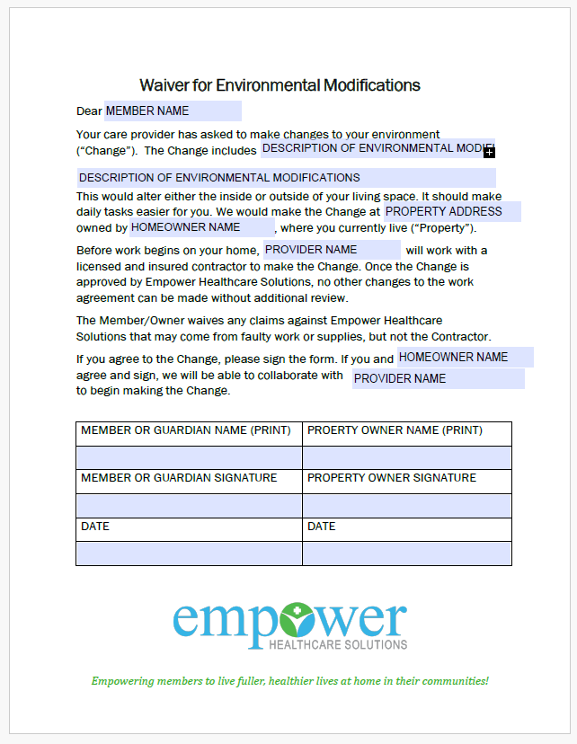
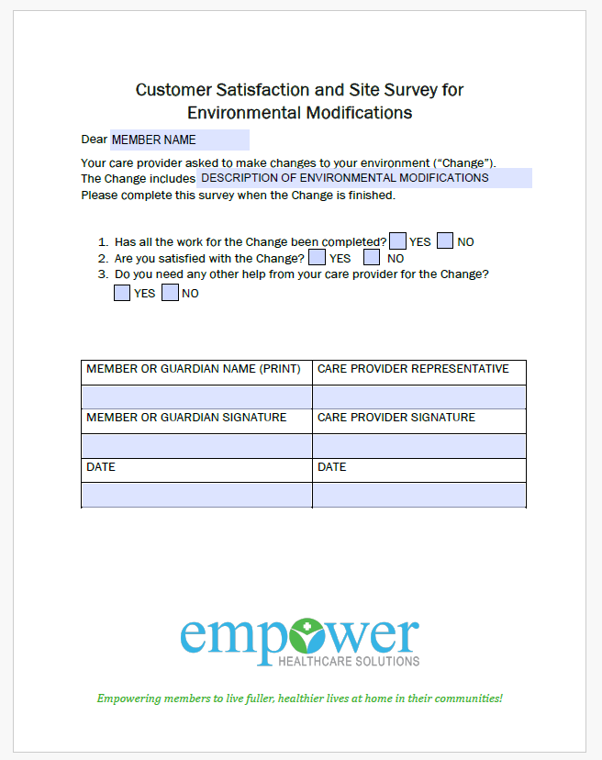
Environmental Modifications

Slide 21
Adaptive equipment
S5160, S5161, S5162
Personal Emergency Response System requests
S5165 U1
Includes vehicle modifications.
Required Documentation:
Letter of medical necessity or justification of equipment.
3 bids if over $1,000
How this helps the member achieve their goals.
Includes rental, purchase, repair, and service fees.

Slide 22
Other services
Annual Limit of $3,690.00
T2020 UA – Supplemental Support Services
Guardianship Requests
Pest Control Treatment
Displaced due to Inclement Weather
T2020 UA U1 – Community Transition Services
Moving from HDC or group home into a residence.
Cannot use for rent, appliances, food, or recreational items.
T2028 – Specialized Medical Supplies
Authorizations for 1 year.
Letter of medical necessity or medical justification.

Slide 23
Specialized Medical supplies
T2028:
Items not furnished under Durable Medical Equipment or Pharmacy benefit.
If items are furnished under the DME benefit, then documentation of limit reached and/or denial before it can be considered for waiver.
Up to a 1-year authorization period.
For medications/supplements:
Letter of medical necessity and/or prescription.

Slide 24
questions
Phone: (855) 429-1028
Fax: (800) 886-6839
Email: utilizationmanagement@empowerarkansas.com

