Slide 1

Utilization management

Slide 2
Utilization management
Empower’s Utilization Management encompasses the following program components for Medical, Behavioral Health, and CES Waiver:
  Prior Authorization or Pre-Certification
  Admission and Concurrent Review
  Retrospective Review
  Discharge Planning
Please refer to the Prior Authorization List for a complete list of services requiring prior authorization:
  https://getempowerhealth.com/procedures/

Slide 3
How to submit a request
Utilization Management is committed to assuring prompt, efficient delivery of healthcare services and to monitor quality of care provided to Empower members.
Prior Authorizations may be requested via:
Online: https://bharportal.valence.care/
Fax: (800) 886-6839 Behavioral Health and CES Waiver
(800) 878-8264 Medical Services
Phone: (855) 429-1028

Slide 4
Processing timelines for requests
Routine
Within 2 business days of receipt of the request.
Possible extension of 4 days if additional clinical is requested.
Urgent
Within 1 business day of receipt of the request.
Possible extension of 1 day if additional clinical is requested.

Slide 5
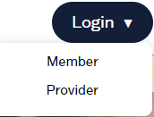
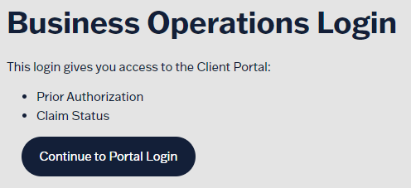
Submitting a request online
Access Provider Portal for Empower online https://getempowerhealth.com/
Select Login, then Provider:
Choose Continue to Portal Login:

Slide 6
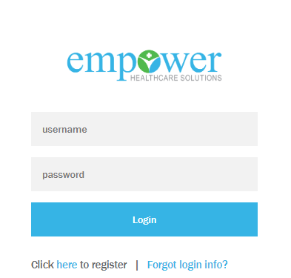
Submitting a request online
Sign-in: https://bharportal.valence.care/
If you’re new to the portal, the select “Click here to register.”
  You will need to provide your TIN and NPI.
  If you need further help, please contact Application Support:
    (888) 959-4031
    support@evolent.com

Slide 7
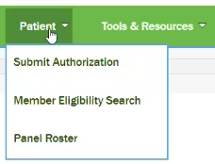
Submitting a request online
3. To start a new authorization, click on the green plus symbol in the top right corner.
Select Patient
Submit Authorization

Slide 8
Submitting a request online
To add an authorization request for a specific beneficiary, click the check symbol to begin a search.

Slide 9
Submitting a request online
Enter requested information:
First Name
Last Name OR
Date of Birth
Patient ID

Slide 10
Submitting a request online
Verify member information is correct.
Choose the appropriate authorization type.
  Once the Request Type has been selected, you can not change to a different request type.

Slide 11
Submitting a request online
Request Type:
Contracted Provider
AOR Required, Encounter ID,
and EMR Account Number
can be left blank.
For Predetermination choose:
Yes for Pre-Certification or service dates are in the future.
No if member has already been admitted to the hospital.

Slide 12
Submitting a request online
Behavioral Health Inpatient
Service Type: Mental Health
CES Waiver
Service Type: Mental Health
Inpatient Medical Admission
Service Type: Medical Care
Personal Care Services
Service Type: Home and Community Based Services
Place of Service: Inpatient Psychiatric Hospital
Place of Service: Office
Place of Service: Inpatient Hospital
Place of Service: Home

Slide 13
Submitting a request online
Enter request service information:
Procedure Description: CPT code with modifier
Total Amount of Units or Days Requested
Start Date
End Date or Duration (i.e. 7 days, 180 days, 3 months)

Slide 14
Submitting a request online
Enter Supporting Documentation:
Attach supporting documentation
Must name attached documents in the following format.
  First Name and Last Name
Once uploaded, a document cannot be voided.
Attach all relevant documents to justify the member’s care (i.e. treatment plan, notes, etc.)

Slide 15
Submitting a request online
Authorization Number and Status

Slide 16
Submitting a request online
To search for an authorization request, choose the funnel symbol and enter the search parameters.

Slide 17
Submitting a request via fax
Behavioral Health or CES Waiver:
Medical Services:
Fax Empower’s Prior Authorization Form for Behavioral Health along with the supporting documentation for the request to (800) 886-6839.
Form is located online: https://getempowerhealth.com/ under the following:
  For Providers
  Provider Material (at the bottom center)
  Form & Resources
  Empower Prior Authorization Form for Behavioral Health or Developmental Disability Providers
Fax Empower’s Prior Authorization Form for Medical Services along with the supporting documentation for the request to (800) 878-8264.
Form is located online: https://getempowerhealth.com/ under the following:
  For Providers
  Provider Material (at the bottom center)
  Form & Resources
  Empower Prior Authorization Form for Medical Services
** Please note that the fax numbers for Behavioral Health and Medical authorizations differ. **

Slide 18
contacts
For questions related to an authorization, please reach out to our Utilization Management team at:
Phone: (855) 429-1028
Email: utilizationmanagement@empowerarkansas.com
For questions related to claims or billing, please reach out to our Provider Relations team at :
Email: empowerhealthcaresolutionspr@empowerarkansas.com

